Slide 1

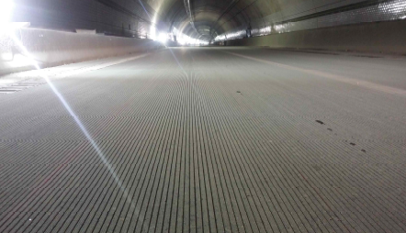
The Next Generation Concrete Surface
PAVEMENT Surface: an important consideration in Korea's long tunnels
Photo courtesy Hexacon, Inc.

Slide 2
NGCS
South Korea may not be known for is size, but it has more than its share of cars. A surface treatment developed in the U.S.—the Next Generation Concrete Surface (NGCS)—has been widely employed on their roadway network to maintain a safe, smooth driving environment for the driving public.
Photo courtesy Hexacon, Inc.

Slide 3
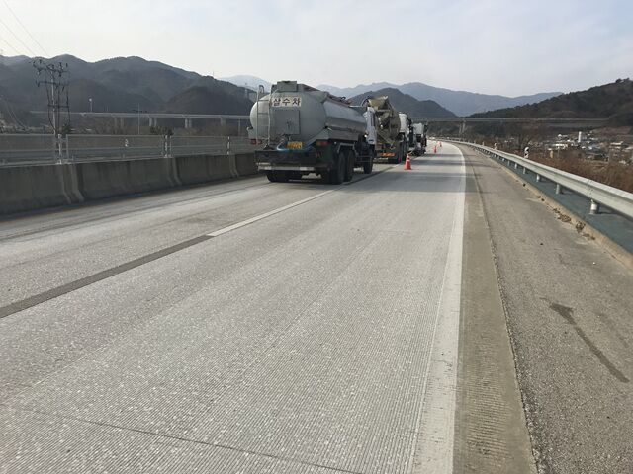
When It All Began
Improvements to the South Korean road network began in the 1960s. Construction of the Gyeongbu Expressway in 1970 was a major milestone. Today, travel times across South Korea have shortened dramatically and by 2020, a national circular road network will be completed.
Photo courtesy Hexacon, Inc.

Slide 4
Need for Tunnels
Because of the topography, South Korea’s road network contains numerous tunnels and bridges. For expressways currently under construction, tunnels represent 43 percent of their length.
Photo courtesy Hexacon, Inc.

Slide 5
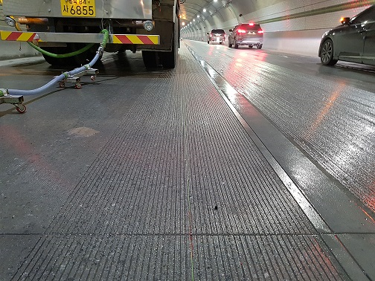
Tunnel Construction Challenges
In addition to the drilling, boring and excavation operations required, the paving operations within these structures pose their own challenges: the tight confines and lack of clearance make it difficult to construct a smooth, quiet and comfortable pavement surface.
Photo courtesy Hexacon, Inc.

Slide 6
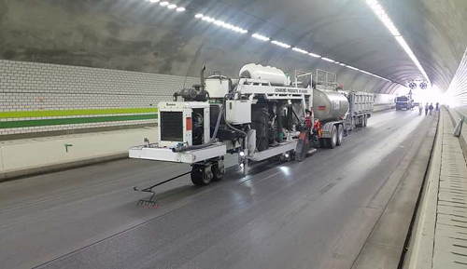
NGCS as a Solution
To help meet their safety needs and high quality standards, the Korea Expressway Corporation (a company that constructs and operates expressway networks in the Republic of Korea and internationally) chose to install NGCS in its tunnels.
Photo courtesy Hexacon, Inc.

Slide 7
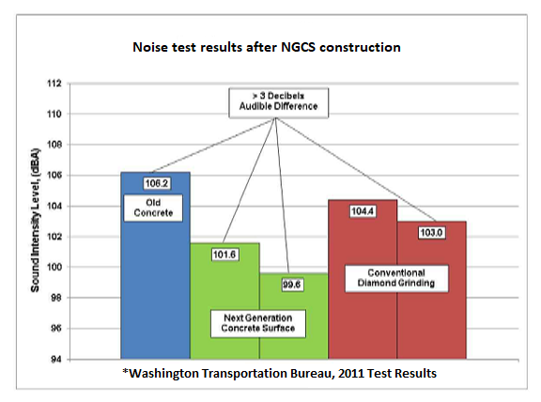
NGCS as a Solution
Developed by the International Grooving & Grinding Association (IGGA) and the American Concrete Pavement Association at Purdue University between 2006 and 2008, NGCS is the quietest, non-porous concrete surface available.
Photo courtesy Hexacon, Inc.

Slide 8
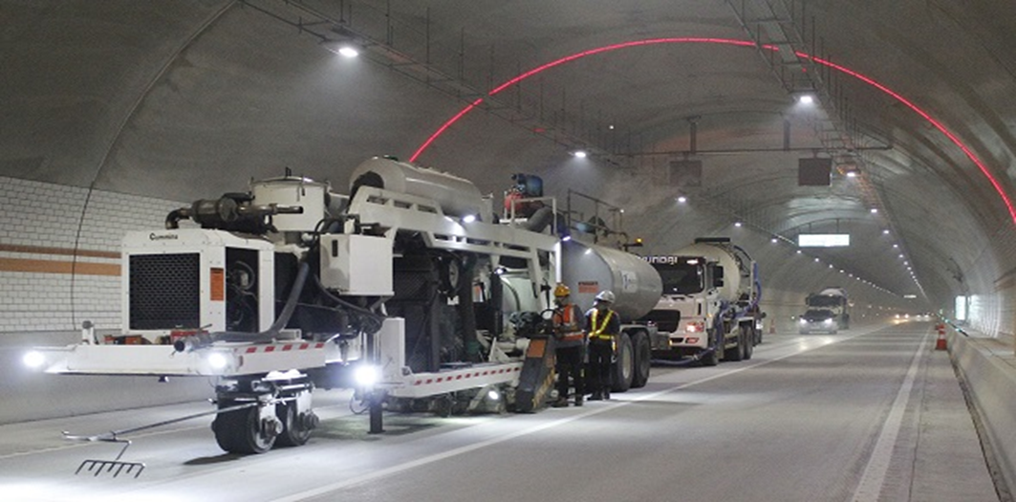
How Is It Installed?
Using conventional diamond grinding equipment, the first step is to flush grind the concrete using 1/8-inch-wide blades with 0.035-inch spacers. (The Korean work used a slightly wider spacer configuration to accommodate local aggregates and concrete mix designs.) Then 1/8-inch-wide longitudinal grooves are saw-cut to a depth of 1/8 to 3/16 at ½- to 5/8-inch centers.
Photo courtesy Hexacon, Inc.

Slide 9
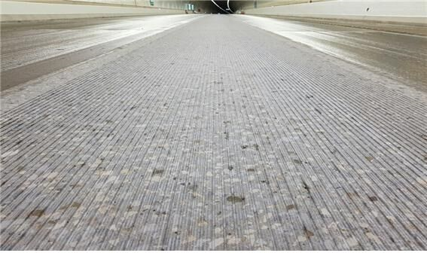
Why NGCS?
Next Generation Concrete Surfaces are smoother and flatter than ordinary pavements. Upward, protruding textures on ordinary pavement are responsible for much of the tire-pavement noise.
NGCS, however, has a consistent profile with a predominantly negative texture, absent of upward texture.
Photo courtesy Hexacon, Inc.

Slide 10
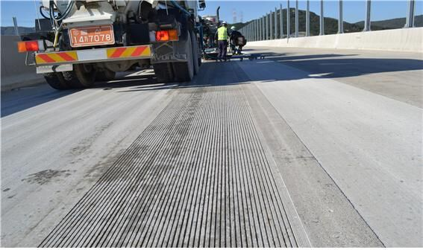
How Much Is Being Used Today?
NGCS is used throughout South Korea on all new expressway tunnels that are two kilometers (1.24 miles) or more in length.
Use of the surface is now expanding to national highways and local roads as well. There are nearly 1.5 million square yards--200 lane miles--of NGCS in South Korea as of 2019.
Photo courtesy Hexacon, Inc.

Slide 11

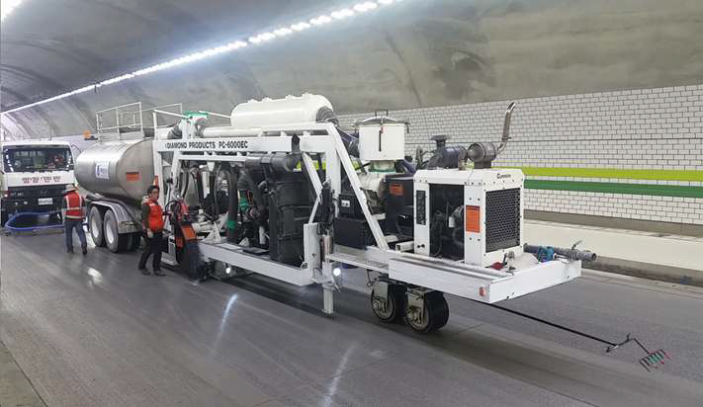
Hexacon, Inc.
NGCS installation performed by IGGA member company Hexacon, Inc. is representative of surface treatments done across the country.
Hexacon was established in 2013, when it acquired two Diamond Products PC-6000 grinding machines and offered services as a diamond grinding company.
Photo courtesy Hexacon, Inc.

Slide 12
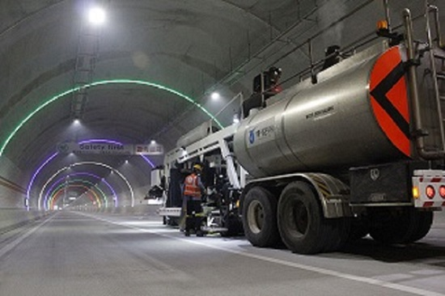
Advantages of NGCS
Currently, most NGCS in South Korea has been installed in tunnels, but the surface is rapidly being applied to highway pavement and bridges because of its various advantages such as:
Quiet ride
Safety
Smooth driving surface
Photo courtesy Hexacon, Inc.

Slide 13
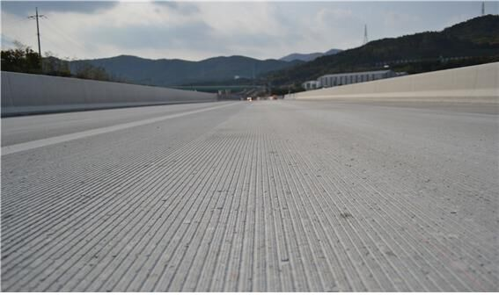
The IGGA Is Proud to Be Part of the Solution
“The NGCS and its smooth, low noise, high friction surface is a perfect fit for the road building and maintenance challenges we see across the globe.”
John Roberts
Executive Director of the IGGA
Photo courtesy Hexacon, Inc.

Slide 14

Contact the IGGA today to learn more.
Read more about Korea’s use of NGCS in Tunnel Business Magazine

